Slide 1
Chapter 8: Main Memory

Slide 2
Chapter 8: Memory Management
Structure of the Page Table
Segmentation
Example: The Intel 32 and 64-bit Architectures

Slide 3
Objectives
To provide a detailed description of various ways of organizing memory hardware
To discuss various memory-management techniques, including paging and segmentation

Slide 4
Memory Protection
Memory protection implemented by associating protection bit with each frame to indicate if read-only or read-write access is allowed
  Can also add more bits to indicate page execute-only, and so on
Valid-invalid bit attached to each entry in the page table:
  “valid” indicates that the associated page is in the process’ logical address space, and is thus a legal page
  “invalid” indicates that the page is not in the process’ logical address space
  Or use page-table length register (PTLR)
Any violations result in a trap to the kernel

Slide 5

Memory Protection
Page Table Length Register (PTLR) is used for protection
interrupt
p d
no
p
yes
Access memory
a
PTLR

Slide 6
Memory Protection
Memory protection implemented by associating protection bit with each frame to indicate if read-only or read-write access is allowed
  Can also add more bits to indicate page execute-only, and so on
Valid-invalid bit attached to each entry in the page table:
  “valid” indicates that the associated page is in the process’ logical address space, and is thus a legal page
  “invalid” indicates that the page is not in the process’ logical address space
Any violations result in a trap to the kernel
Page table
p R W E

Slide 7

Valid (v) or Invalid (i) Bit In A Page Table

Slide 8
Shared Pages
Shared code
  One copy of read-only (reentrant) code shared among processes (i.e., text editors, compilers, window systems)
  Similar to multiple threads sharing the same process space
  Also useful for interprocess communication if sharing of read-write pages is allowed
Private code and data
  Each process keeps a separate copy of the code and data
  The pages for the private code and data can appear anywhere in the logical address space

Slide 9

Shared Pages Example

Slide 10
Structure of the Page Table
Memory structures for paging can get huge using straight-forward methods
  Consider a 32-bit logical address space as on modern computers
  Page size of 4 KB (2¹²)
  Page table would have 1 million entries (2³² / 2¹²)
  If each entry is 4 bytes -> 4 MB of physical address space / memory for page table alone
    That amount of memory used to cost a lot
    Don’t want to allocate that contiguously in main memory
Hierarchical Paging
Hashed Page Tables
Inverted Page Tables

Slide 11
Hierarchical Page Tables
Break up the logical address space into multiple page tables
A simple technique is a two-level page table
We then page the page table

Slide 12

Two-Level Page-Table Scheme

Slide 13
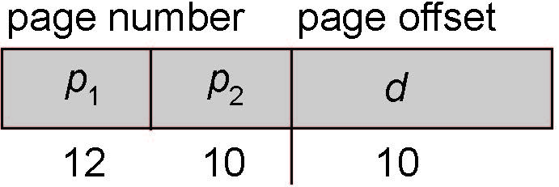
Two-Level Paging Example
A logical address (on 32-bit machine with 1K page size) is divided into:
  a page number consisting of 22 bits
  a page offset consisting of 10 bits
Since the page table is paged, the page number is further divided into:
  a 12-bit page number
  a 10-bit page offset
Thus, a logical address is as follows:
where p₁ is an index into the outer page table, and p₂ is the displacement within the page of the inner page table
Known as forward-mapped page table

Slide 14

Address-Translation Scheme

Slide 15
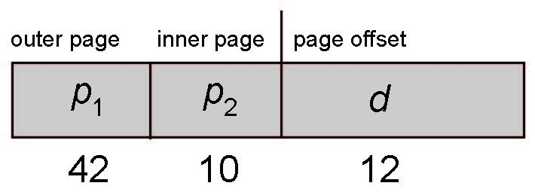
64-bit Logical Address Space
Even two-level paging scheme not sufficient
If page size is 4 KB (2¹²)
  Then page table has 2⁵² entries
  If two level scheme, inner page tables could be 2¹⁰ 4-byte entries
  Address would look like
  Outer page table has 2⁴² entries or 2⁴⁴ bytes
  One solution is to add a 2nd outer page table
  But in the following example the 2nd outer page table is still 2³⁴ bytes in size
    And possibly 4 memory access to get to one physical memory location

Slide 16


Three-level Paging Scheme

Slide 17
Hashed Page Tables
Common in address spaces > 32 bits
The virtual page number is hashed into a page table
  This page table contains a chain of elements hashing to the same location
Each element contains (1) the virtual page number (2) the value of the mapped page frame (3) a pointer to the next element
Virtual page numbers are compared in this chain searching for a match
  If a match is found, the corresponding physical frame is extracted
Variation for 64-bit addresses is clustered page tables
  Similar to hashed but each entry refers to several pages (such as 16) rather than 1
  Especially useful for sparse address spaces (where memory references are non-contiguous and scattered)

Slide 18

Hashed Page Table

Slide 19
Inverted Page Table
Rather than each process having a page table and keeping track of all possible logical pages, track all physical pages
One entry for each real page of memory
Entry consists of the virtual address of the page stored in that real memory location, with information about the process that owns that page
Decreases memory needed to store each page table, but increases time needed to search the table when a page reference occurs
Use hash table to limit the search to one — or at most a few — page-table entries
  TLB can accelerate access
But how to implement shared memory?
  One mapping of a virtual address to the shared physical address

Slide 20

Inverted Page Table Architecture

Slide 21
Segmentation
Memory-management scheme that supports user view of memory
A program is a collection of segments
  A segment is a logical unit such as:
main program
procedure
function
method
object
local variables, global variables
common block
stack
symbol table
arrays

Slide 22

User’s View of a Program

Slide 23
Logical View of Segmentation
1
1
4
2
3
4
2
3
user space
physical memory space

Slide 24
Segmentation Architecture
Logical address consists of a two tuple:
<segment-number, offset>,
Segment table – maps two-dimensional physical addresses; each table entry has:
  base – contains the starting physical address where the segments reside in memory
  limit – specifies the length of the segment
Segment-table base register (STBR) points to the segment table’s location in memory
Segment-table length register (STLR) indicates number of segments used by a program;
segment number s is legal if s < STLR

Slide 25
Segmentation Architecture
Logical address consists of a two tuple: <s, d>, where “s” is the virtual segment number and “d” is the displacement from the start of the segment
“a” is the base address of where the segment table starts for this process.
CPU
s d
+
s+a d
a
“s+a” is the real address where the segment information is

Slide 26
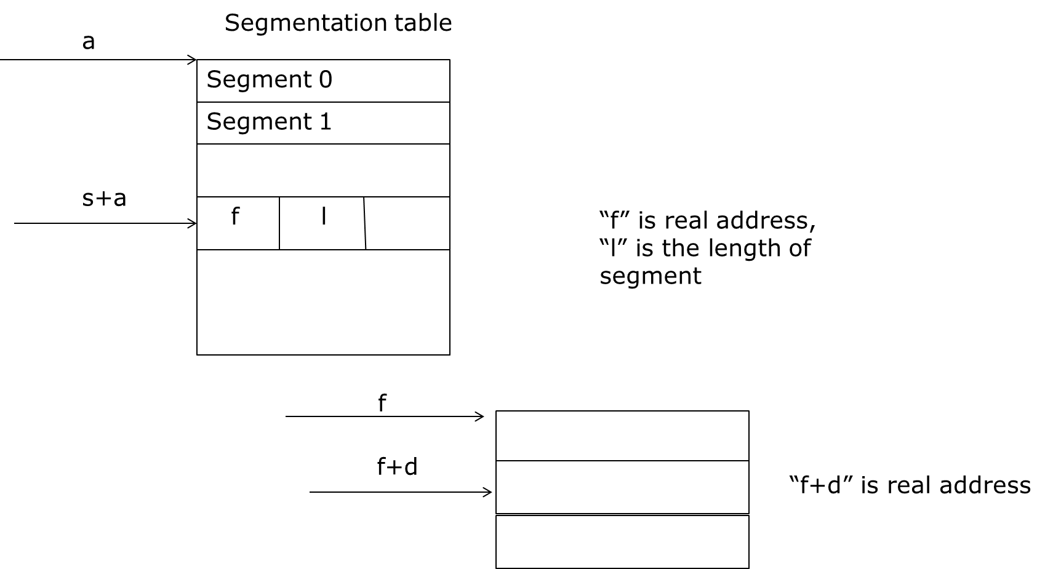
Segmentation Architecture
Segmentation table

Slide 27
Segmentation Architecture (Cont.)
Protection
  With each entry in segment table associate:
    validation bit = 0 ⇒ illegal segment
    read/write/execute privileges
s+a
f l RWE v
“v” indicate if segment is valid. RWE bits indicate what is allowed on this page read-write-execute
If “d” >”l” then interrupt

Slide 28
Segmentation Architecture (Cont.)
Sharing segments
  The segment table of each process can store the address of the segment that is to be shared
Since segments vary in length, memory allocation is a dynamic storage-allocation problem
A segmentation example is shown in the following diagram

Slide 29

Segmentation Hardware

Slide 30
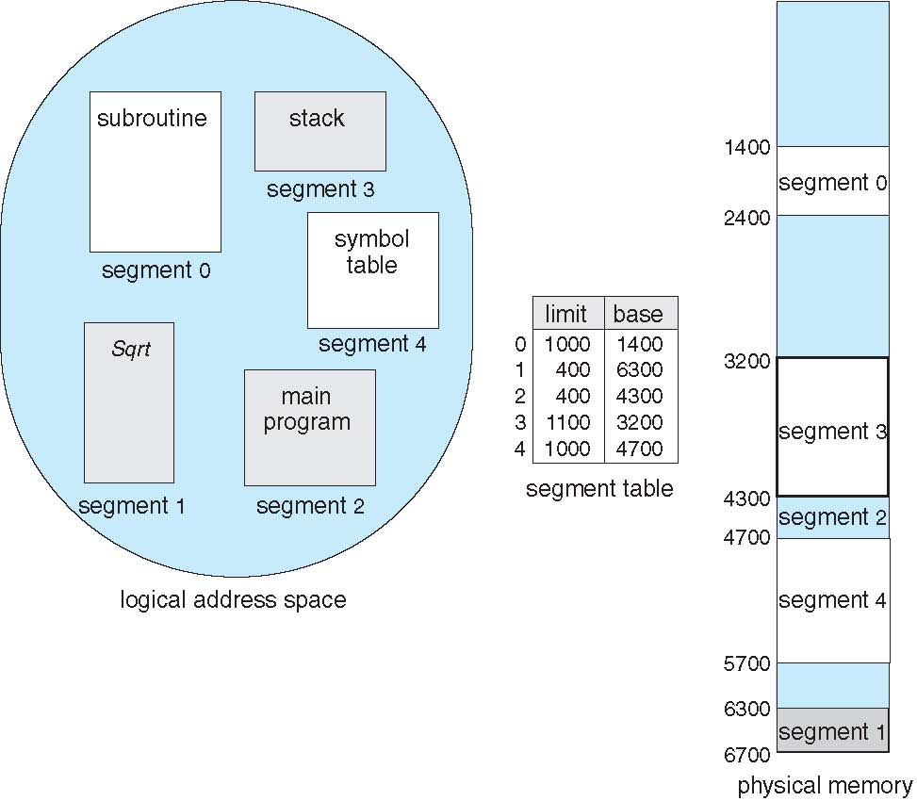
Example of Segmentation

Slide 31
Comparing Paging and Segmentation
Sharing is done more easily with segmentation because segments can expand to hold an entire procedure or data structure while these would expand over several pages in paging system
Protection is easy to implement in segmentation because all entries in a segment will be of the same type. For example, a segment may consist of all unmodifiable instructions and protected against modification while another segment may consist of all data that can be modified
Fragmentation is less in paging than in segmentation because there is no external fragmentation with paging

Slide 32
Combining Paging and Segmentation
Virtual address =(s, p, d)
  “s” is the virtual segment number, “p” the page number within this segment and “d” is the displacement from the start of page
Segments are multiple pages in size. The pages of a segment do not need to be contiguous in main memory nor they all need to be in main memory at the same time. This is an obvious advantage over pure segmentation systems
Every process has a segment table and each segment has a page table. Thus there are multiple page tables per process

Slide 33
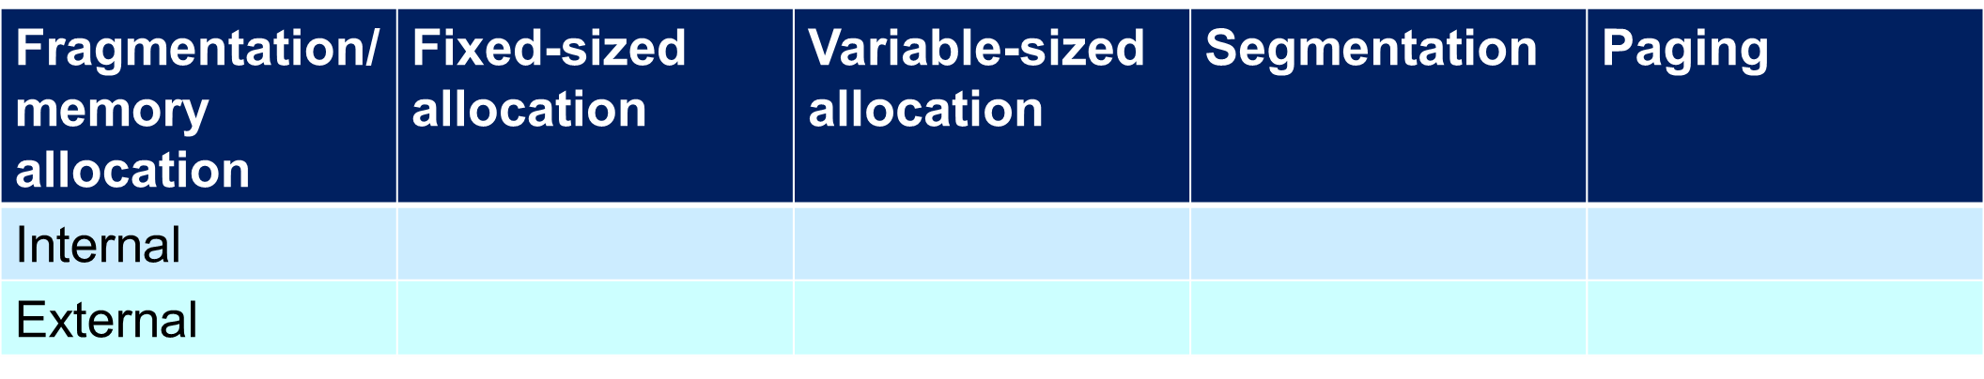
Quiz

Slide 34
Oracle SPARC Solaris
Consider modern, 64-bit operating system example with tightly integrated HW
  Goals are efficiency, low overhead
Based on hashing, but more complex
Two hash tables
  One kernel and one for all user processes
  Each maps memory addresses from virtual to physical memory
  Each entry represents a contiguous area of mapped virtual memory,
    More efficient than having a separate hash-table entry for each page
  Each entry has base address and span (indicating the number of pages the entry represents)

Slide 35
Oracle SPARC Solaris (Cont.)
TLB holds translation table entries (TTEs) for fast hardware lookups
  A cache of TTEs reside in a translation storage buffer (TSB)
    Includes an entry per recently accessed page
Virtual address reference causes TLB search
  If miss, hardware walks the in-memory TSB looking for the TTE corresponding to the address
    If match found, the CPU copies the TSB entry into the TLB and translation completes
    If no match found, kernel interrupted to search the hash table
      The kernel then creates a TTE from the appropriate hash table and stores it in the TSB, Interrupt handler returns control to the MMU, which completes the address translation.

Slide 36
Example: The Intel 32 and 64-bit Architectures
Dominant industry chips
Pentium CPUs are 32-bit and called IA-32 architecture
Current Intel CPUs are 64-bit and called IA-64 architecture
Many variations in the chips, cover the main ideas here

Slide 37
Example: The Intel IA-32 Architecture
Supports both segmentation and segmentation with paging
  Each segment can be 4 GB
  Up to 16 K segments per process
  Divided into two partitions
    First partition of up to 8 K segments are private to process (kept in local descriptor table (LDT))
    Second partition of up to 8K segments shared among all processes (kept in global descriptor table (GDT))

Slide 38

Example: The Intel IA-32 Architecture (Cont.)
CPU generates logical address
  Selector given to segmentation unit
    Which produces linear addresses
  Linear address given to paging unit
    Which generates physical address in main memory
    Paging units form equivalent of MMU
    Pages sizes can be 4 KB or 4 MB

Slide 39


Logical to Physical Address Translation in IA-32

Slide 40
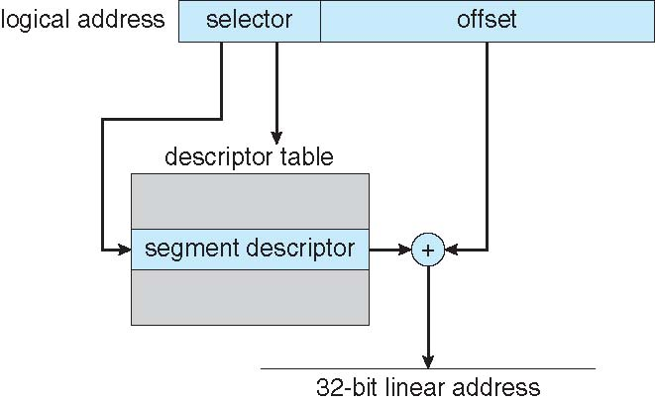
Intel IA-32 Segmentation

Slide 41

Intel IA-32 Paging Architecture

Slide 42
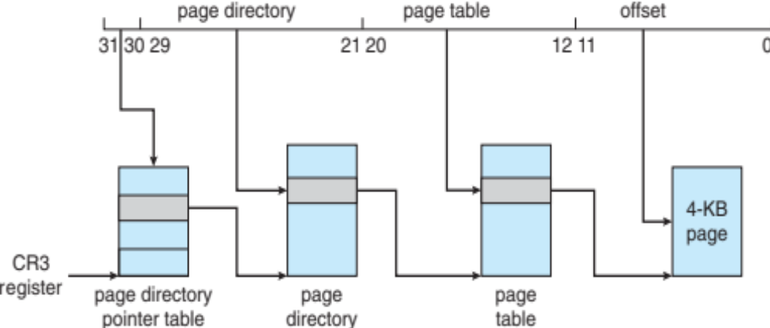
Intel IA-32 Page Address Extensions
32-bit address limits led Intel to create page address extension (PAE), allowing 32-bit apps access to more than 4GB of memory space
  Paging went to a 3-level scheme
  Top two bits refer to a page directory pointer table
  Page-directory and page-table entries moved to 64-bits in size
  Net effect is increasing address space to 36 bits – 64GB of physical memory

Slide 43
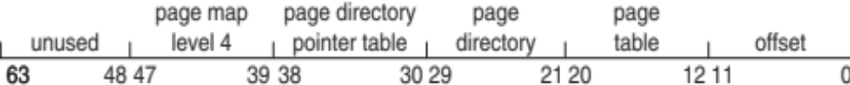
Intel x86-64
Current generation Intel x86 architecture
64 bits is ginormous (> 16 exabytes)
In practice only implement 48 bit addressing
  Page sizes of 4 KB, 2 MB, 1 GB
  Four levels of paging hierarchy
Can also use PAE so virtual addresses are 48 bits and physical addresses are 52 bits

Slide 44
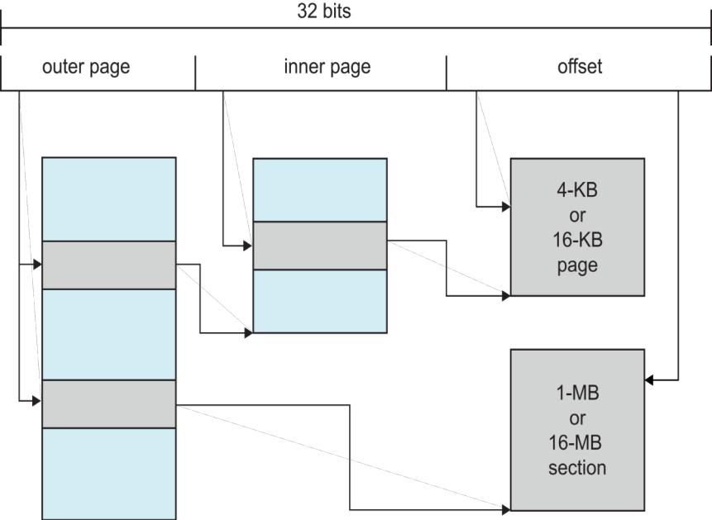
Example: ARM Architecture
Dominant mobile platform chip (Apple iOS and Google Android devices for example)
Modern, energy efficient, 32-bit CPU
4 KB and 16 KB pages
1 MB and 16 MB pages (termed sections)
One-level paging for sections, two-level for smaller pages
Two levels of TLBs
  Outer level has two micro TLBs (one data, one instruction)
  Inner is single main TLB
  First inner is checked, on miss outers are checked, and on miss page table walk performed by CPU

Slide 45
End of Chapter 8

